Slide 1


INNOVATION DRIVES FOOD INDUSTRY
Shanghai,China
Foodmate Co., Ltd.
www.foodmategroup.com

Slide 2
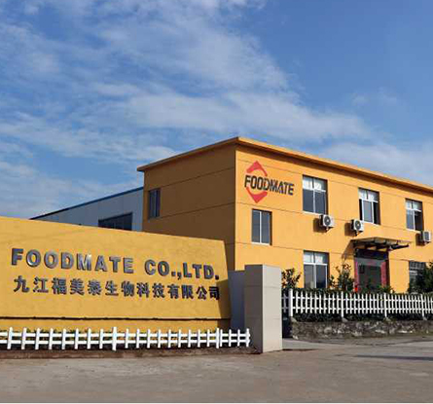
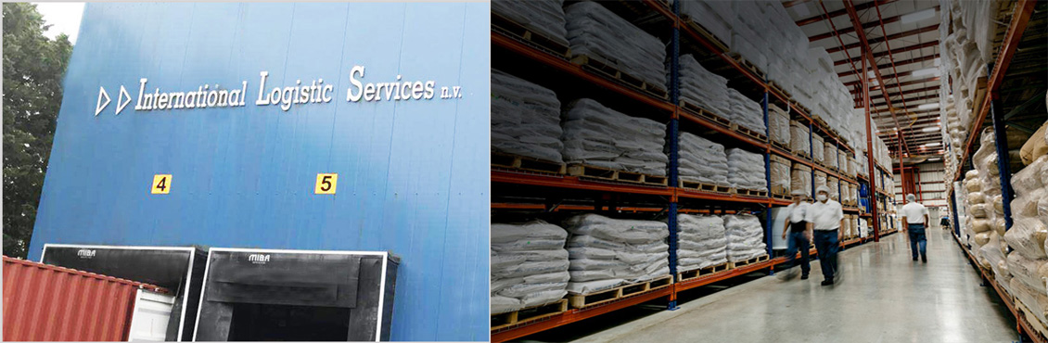

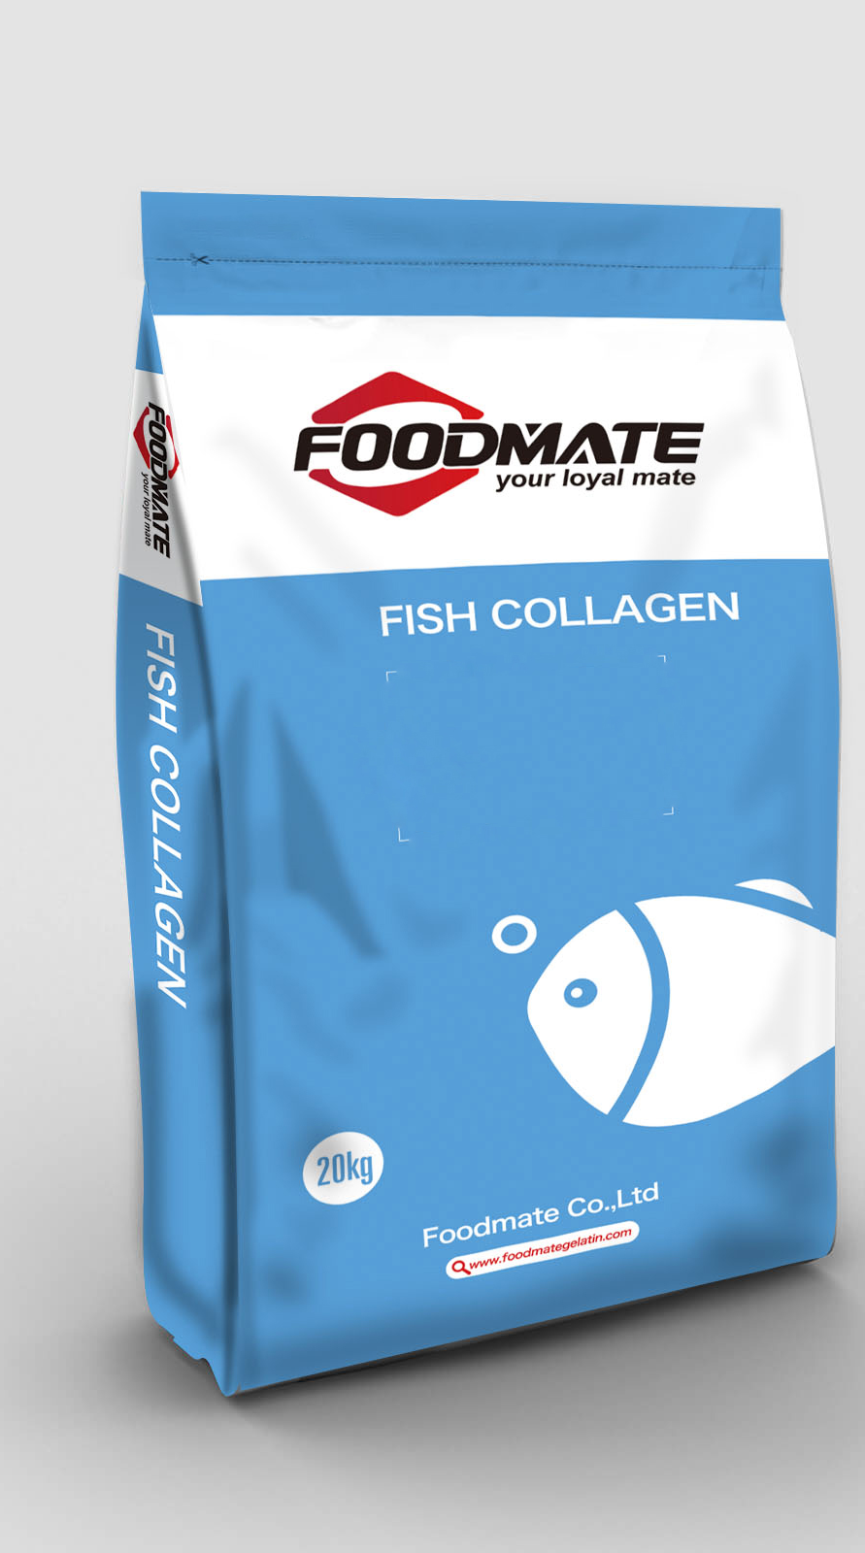
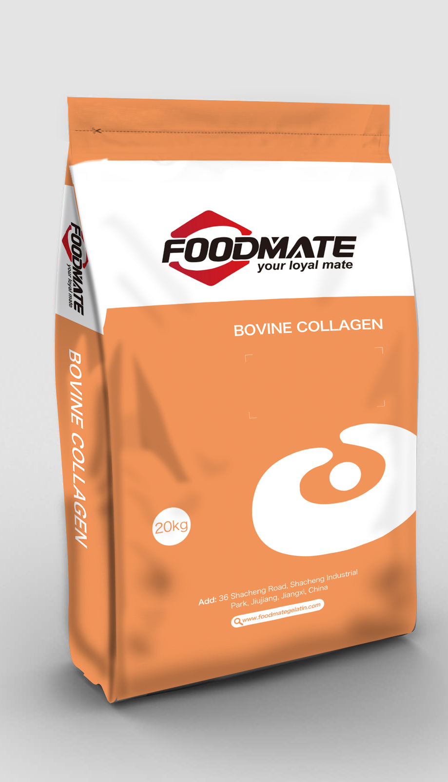

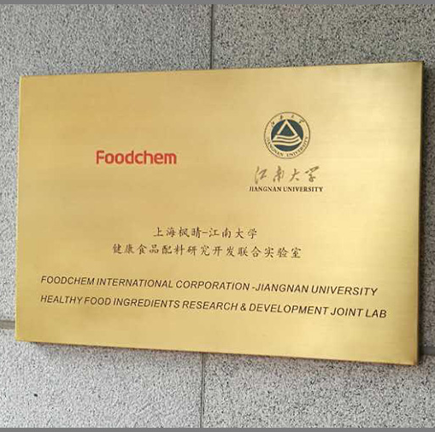
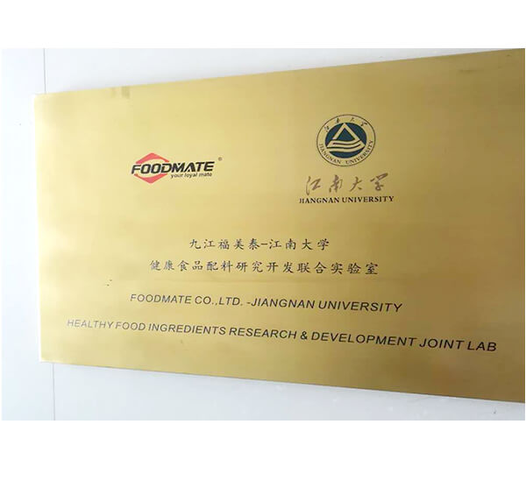




01
Company Introduction
Provide Innovative Solutions for Food Production
Foodmate is one of the earliest companies engaged in the research and development and production of food additives and ingredients in China, and we arecommitted to provide one-stop application solutions for customers in nutrition＆health, bakery, beverage, meat products and other fields.
Group Founded
in Shanghai
Manufacturer
starts to operation
North American and European Warehouse Established
Launched
Collagen project
2012
2014
2017
2019
2006
2013
2015
2018
Founded
in Jiangxi
Set up
Shanghai Lab
Established
Joint Lab with
Jiangnan University
Four business divisions
established
www.foodmategroup.com

Slide 3
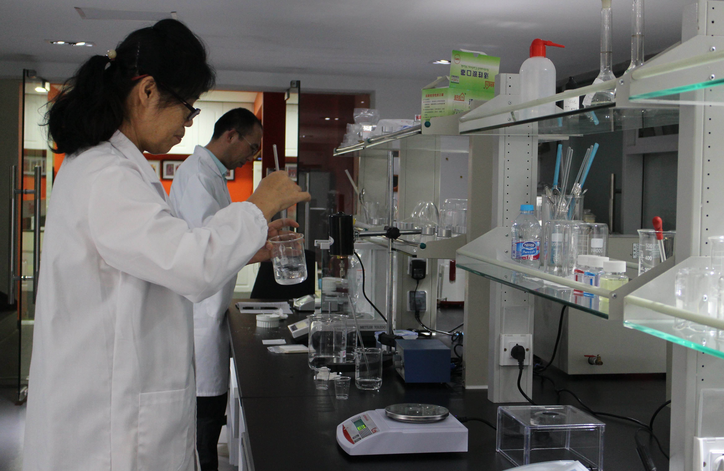
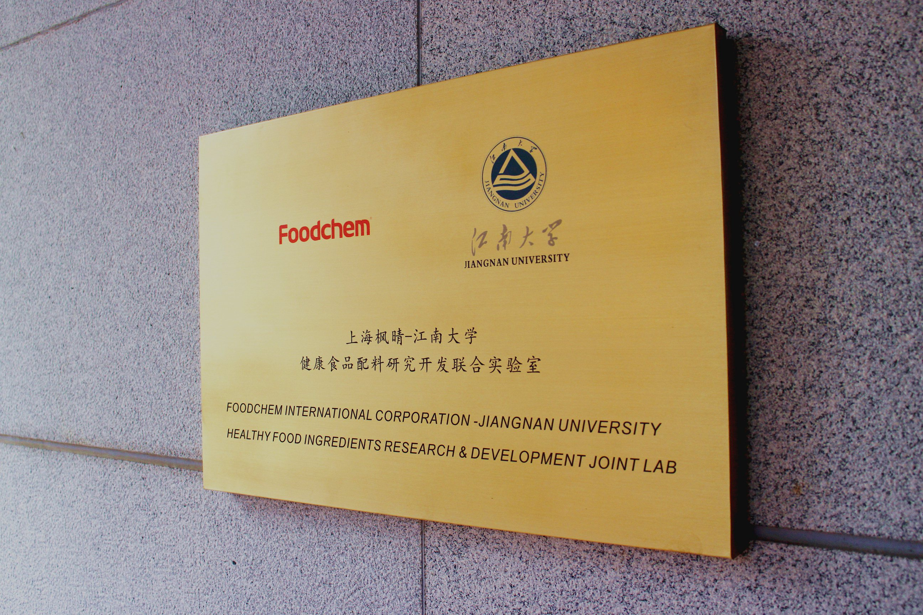


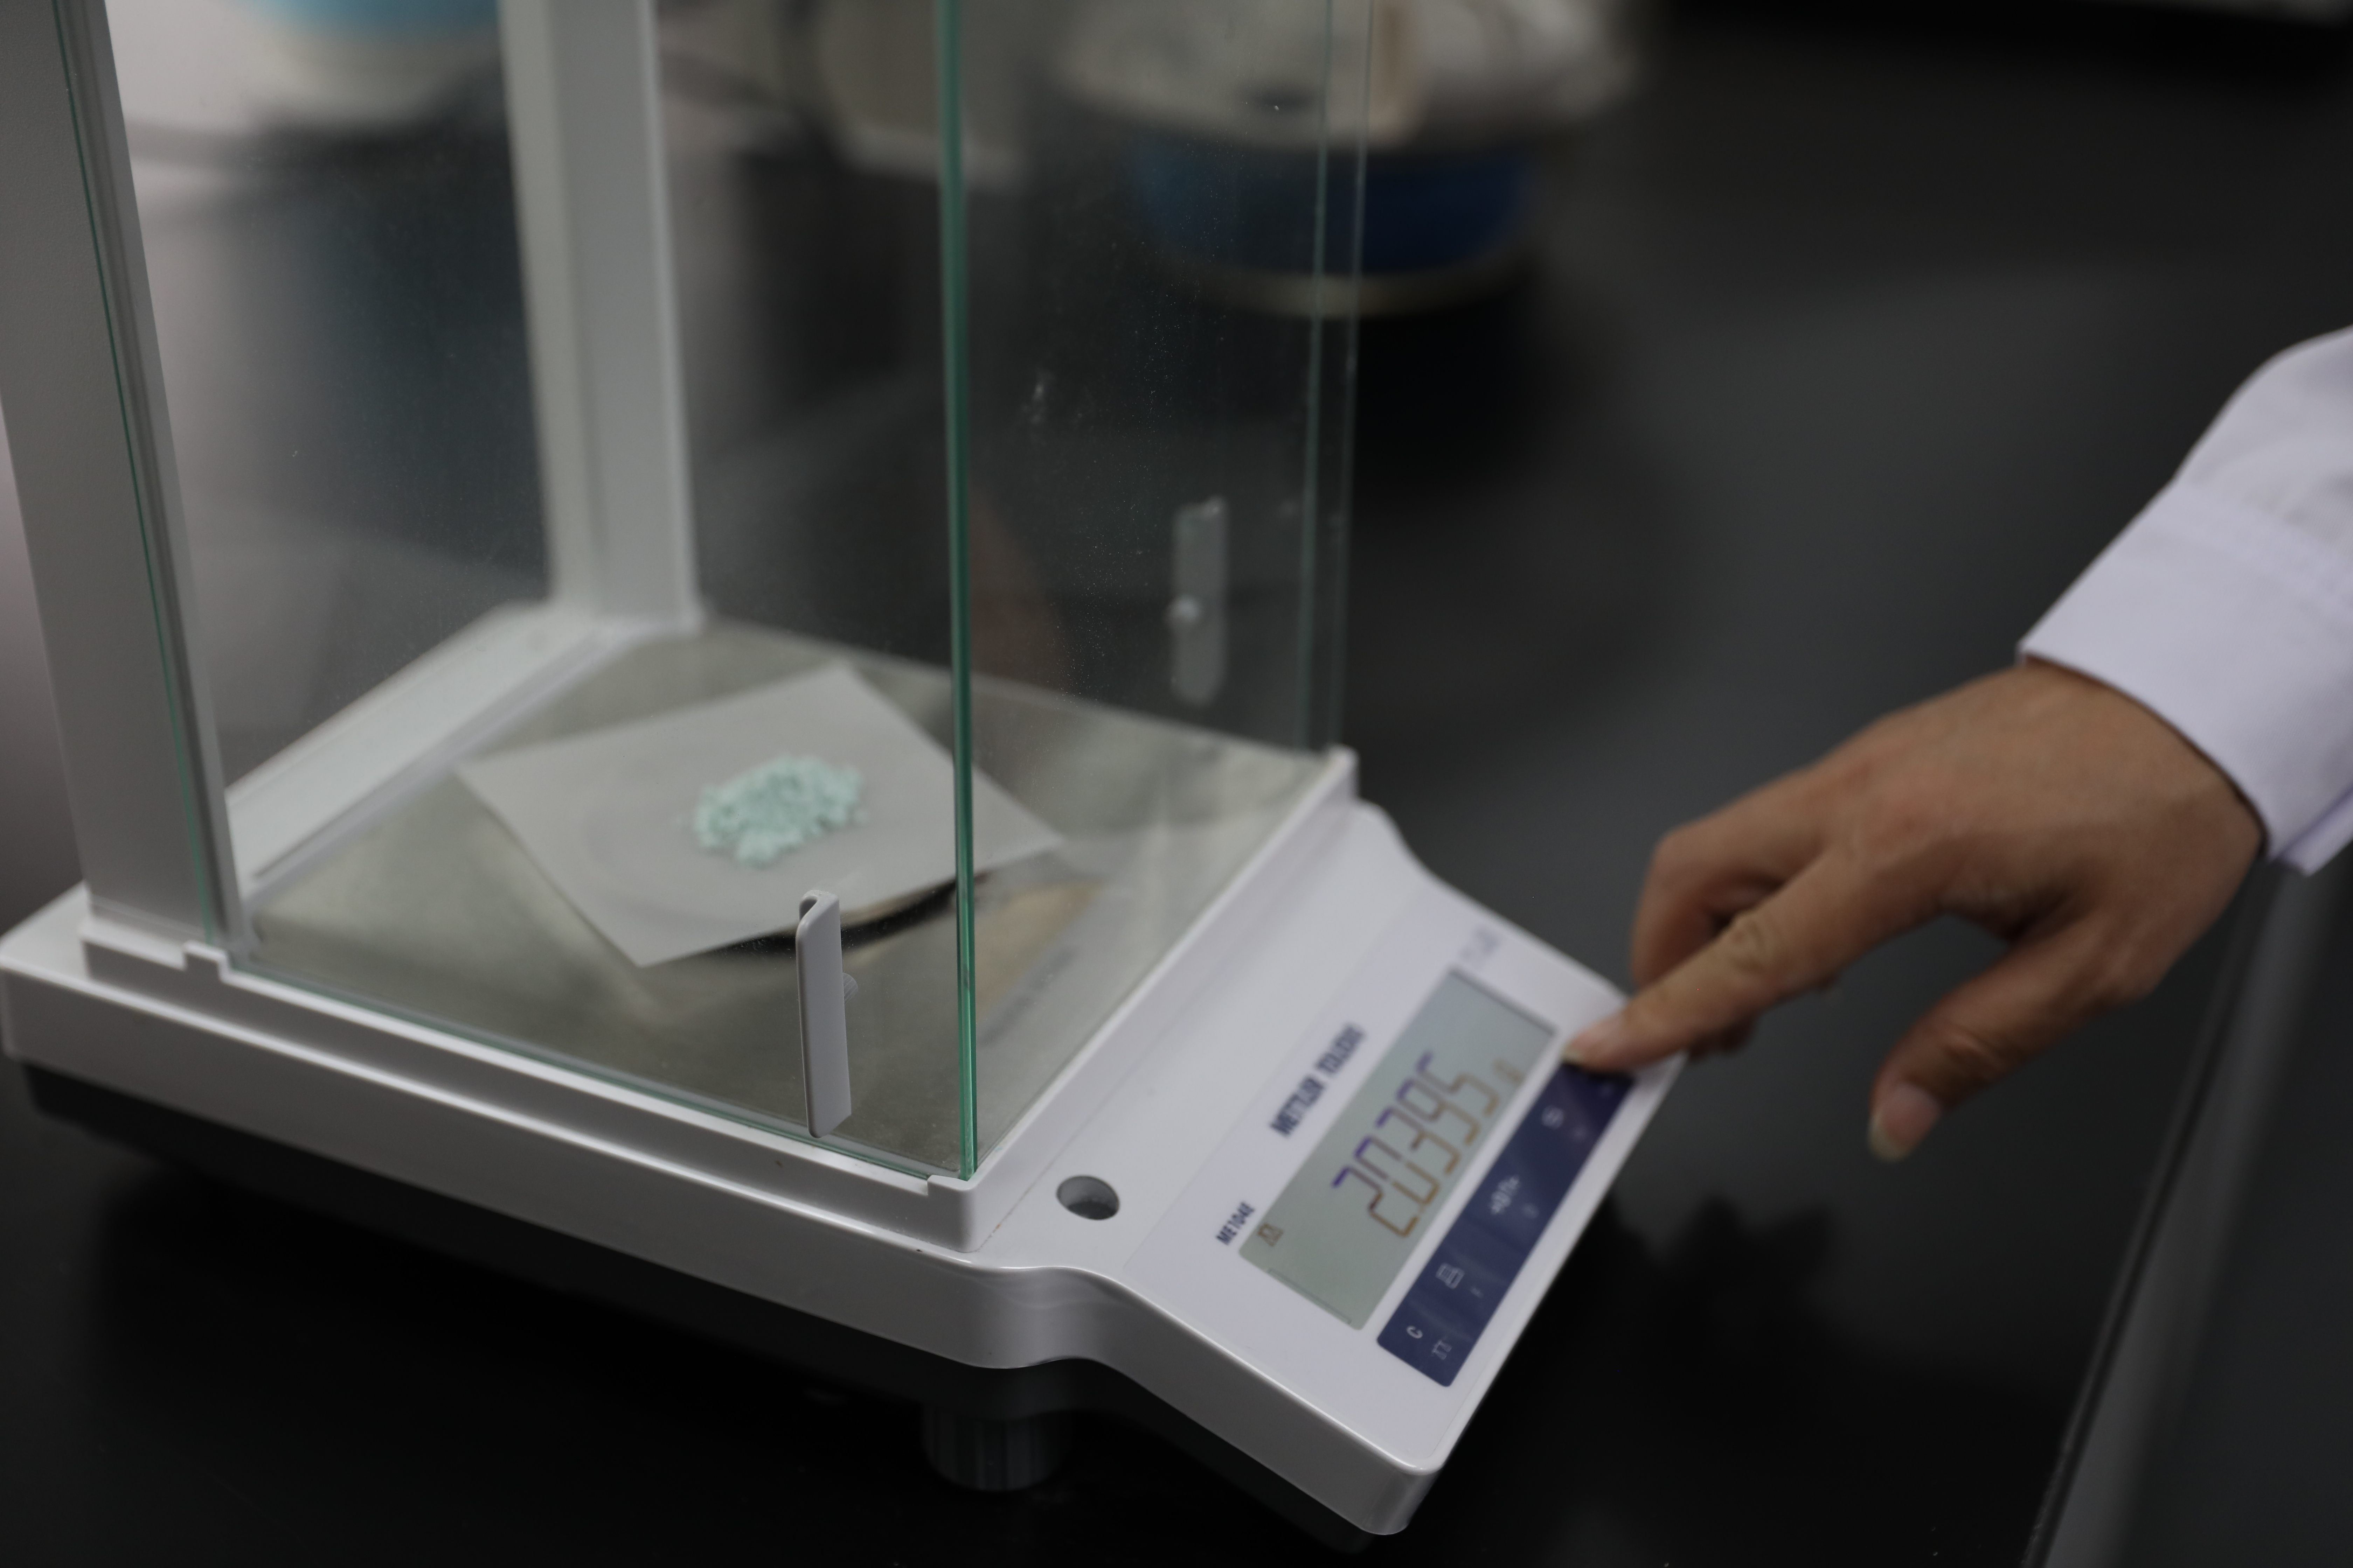
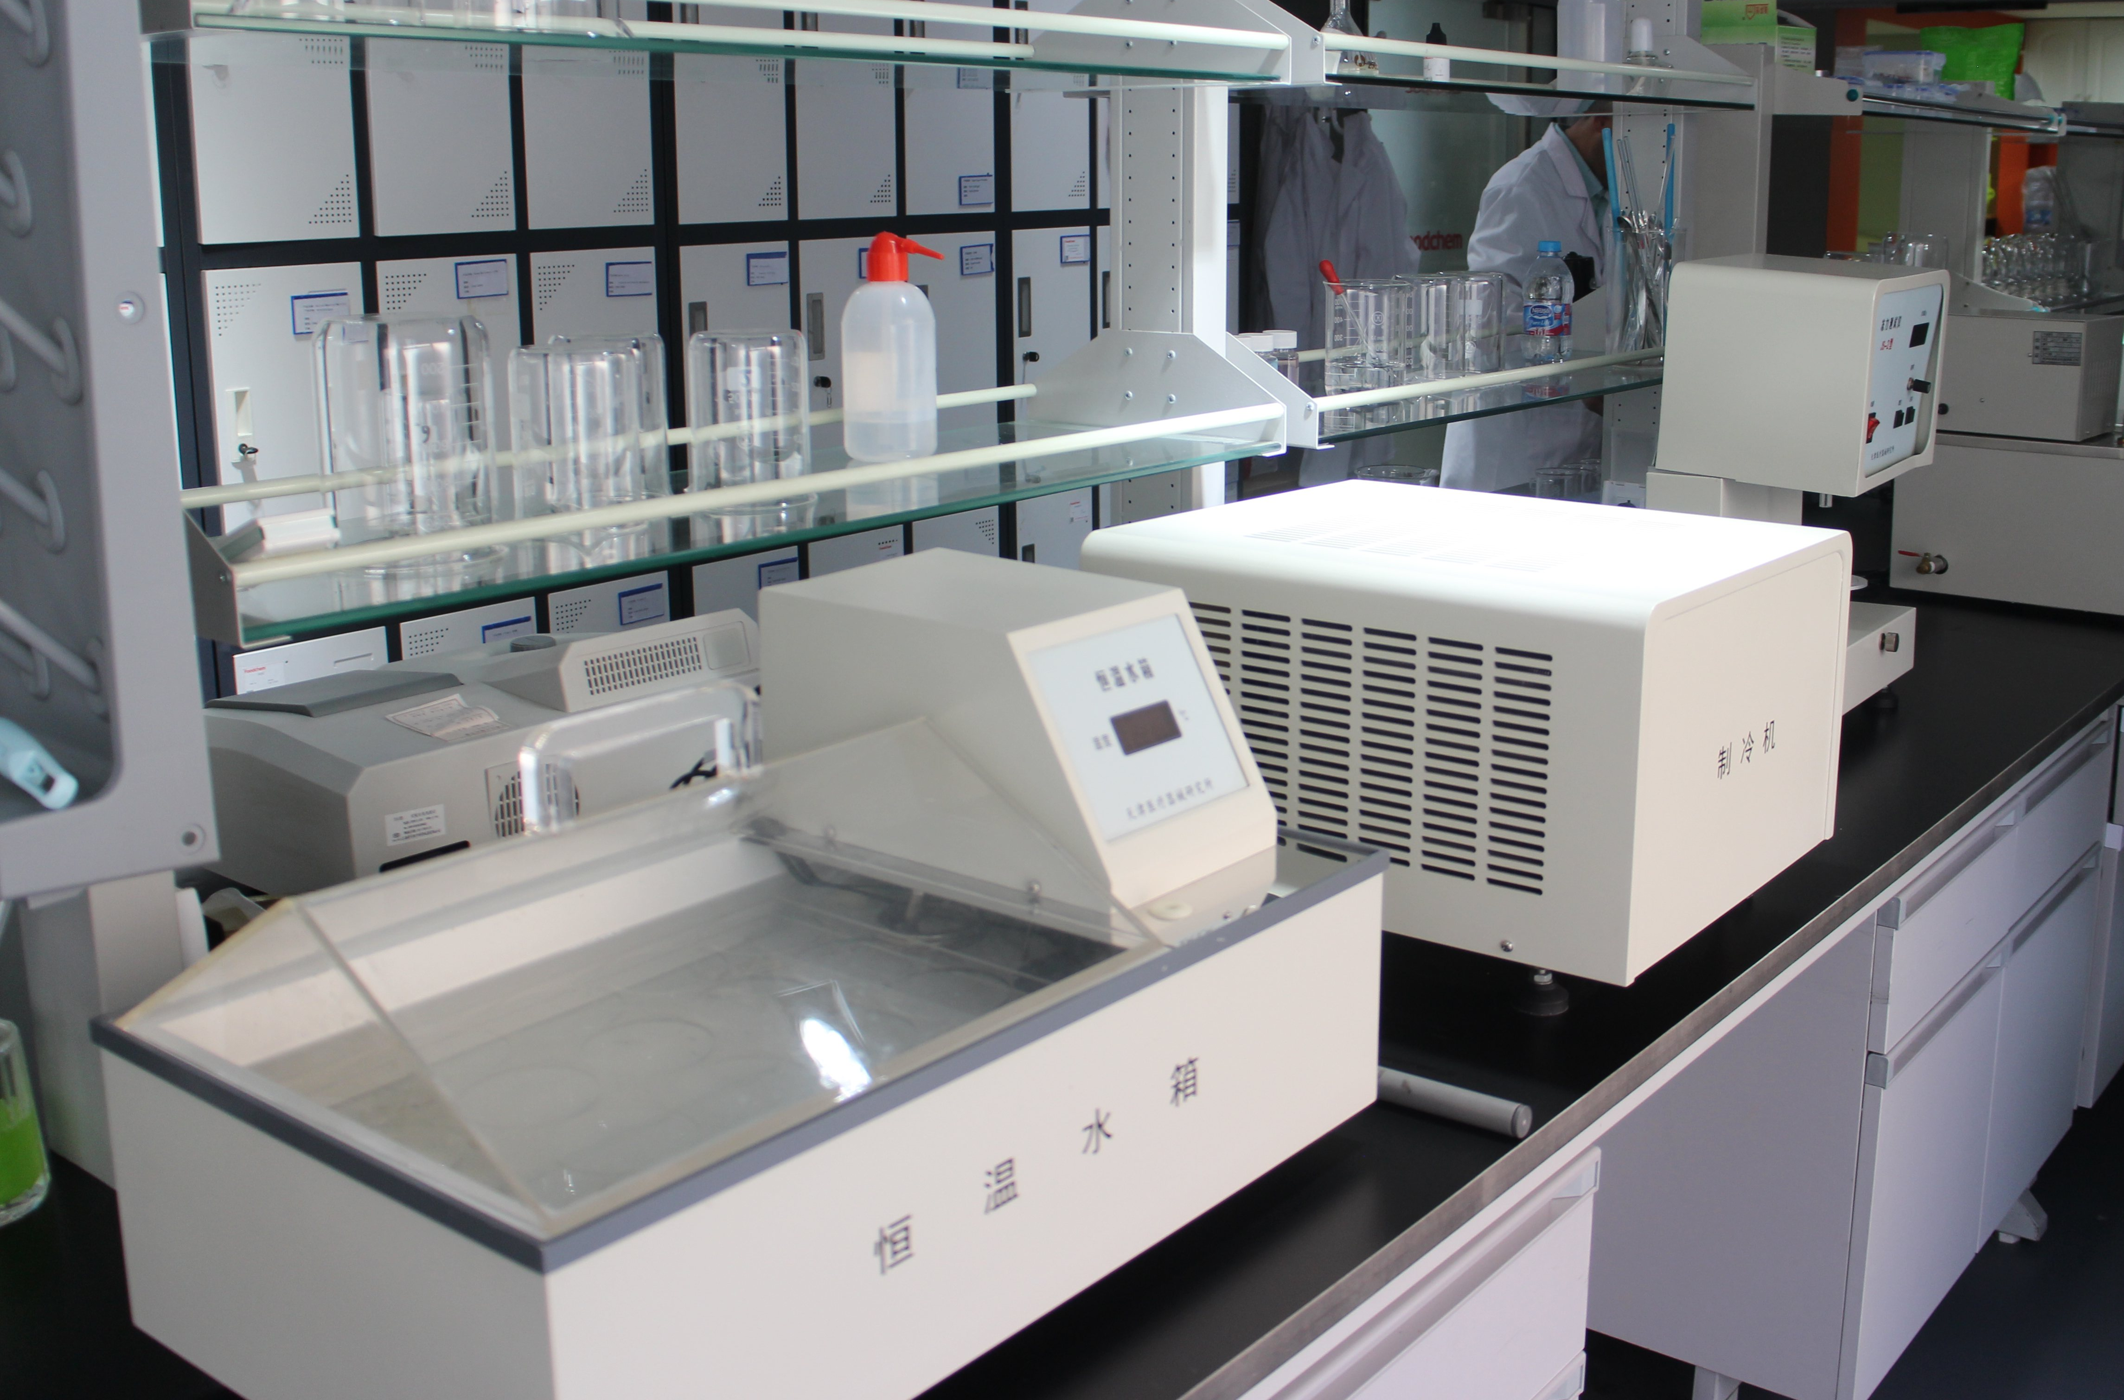

02
R＆D System
Industry-leading Product and Application R&D System
Foodmate has set up a professional research and development team, built a modern laboratory, and established a joint laboratory with jiangnan university and other universities and research institutions. As a result, we now have industry-leading r&d capabilities.
Full time R&D Science
Education: Postgraduate or above
School: Food science major ranked top 5 in China
Experience: Over 8 years of R&D experience in food industry
Strategy Consultants
Professor，R&D Scientists from World famous food enterprises
President of industry associations
College-Enterprise Cooperation
Jiangnan university
China Agricultural university
Nanchang university
Zhejiang university
www.foodmategroup.com

Slide 4



03
Quality System
Quality Control System
Foodmate strictly controls the quality of products, from production to transportation, in order to provide customers with assured high quality products and services.
Our People
Quality Control
Our Facility
Joint Test
More than 15 years average working experience
6 full-time Senior Chemist
8 undergraduates and above
Strictly implement the quality management system HACCP, ISO 9001, ISO 22000, FSSC 22000, HALAL
National first-class instrument
Send to the national legal inspection agency
Formulate a periodic verification plan
Daily cleaning of testing instrument
Factory Quality Lab.
Shanghai R&D center
www.foodmategroup.com

Slide 5


03
Quality System
Inspection before Shipment
Foodmate strictly controls the quality of products, from production to transportation, in order to provide customers with assured high quality products and services.
Self-inspection
Quality
Quantity
Package details (share cargo photo and video to clients before delivery)
Customer inspection
Support pre-shipment sample test before delivery (attached with our test method)
Support Client-designated third-party test (like：SGS,BV etc)
Support customer on-site inspection
www.foodmategroup.com

Slide 6
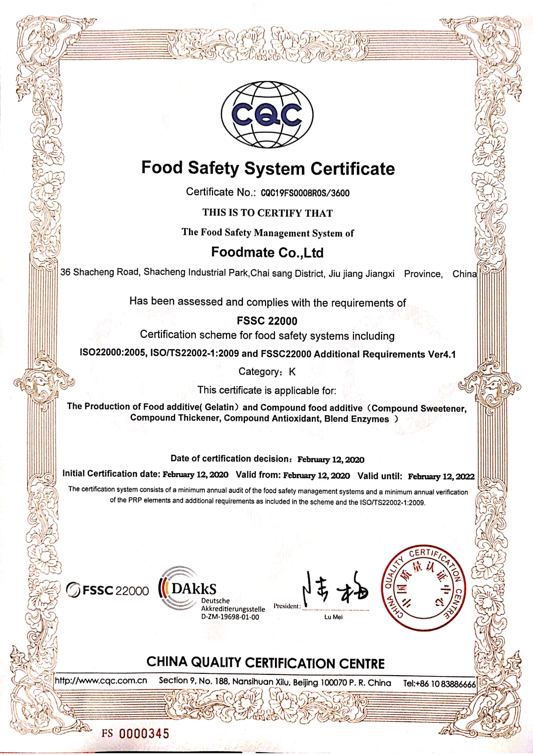
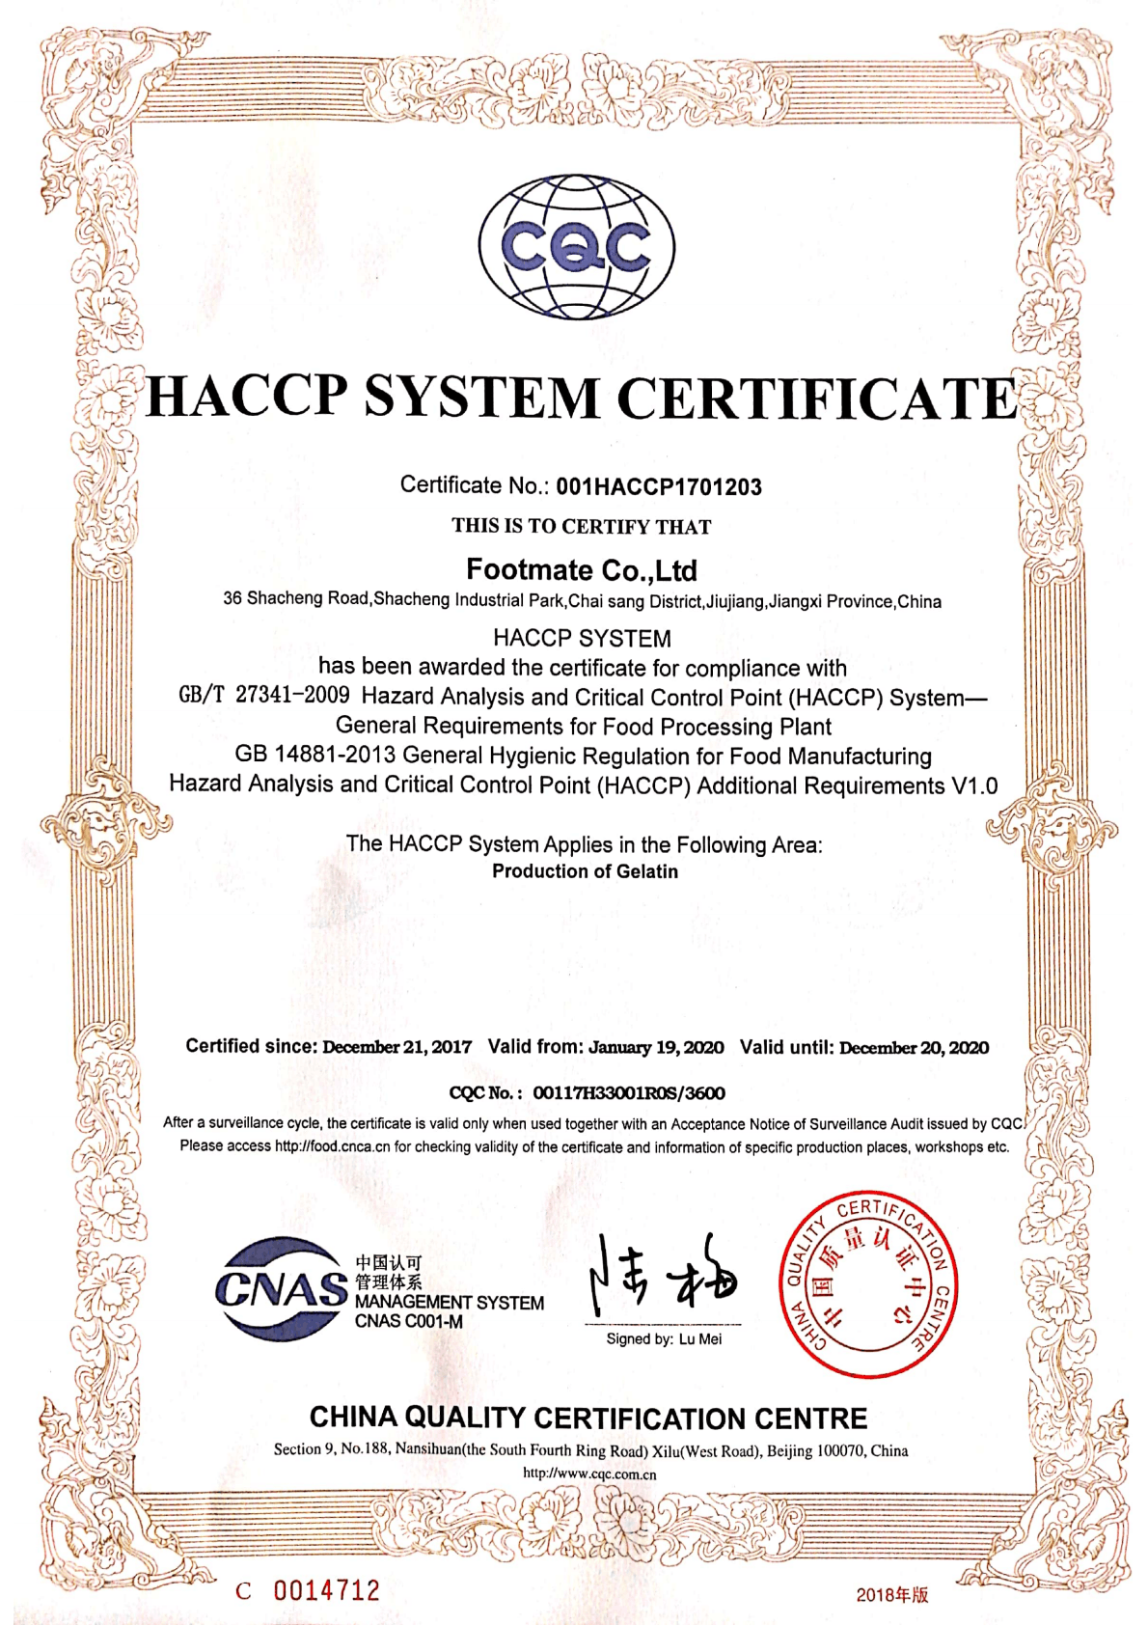
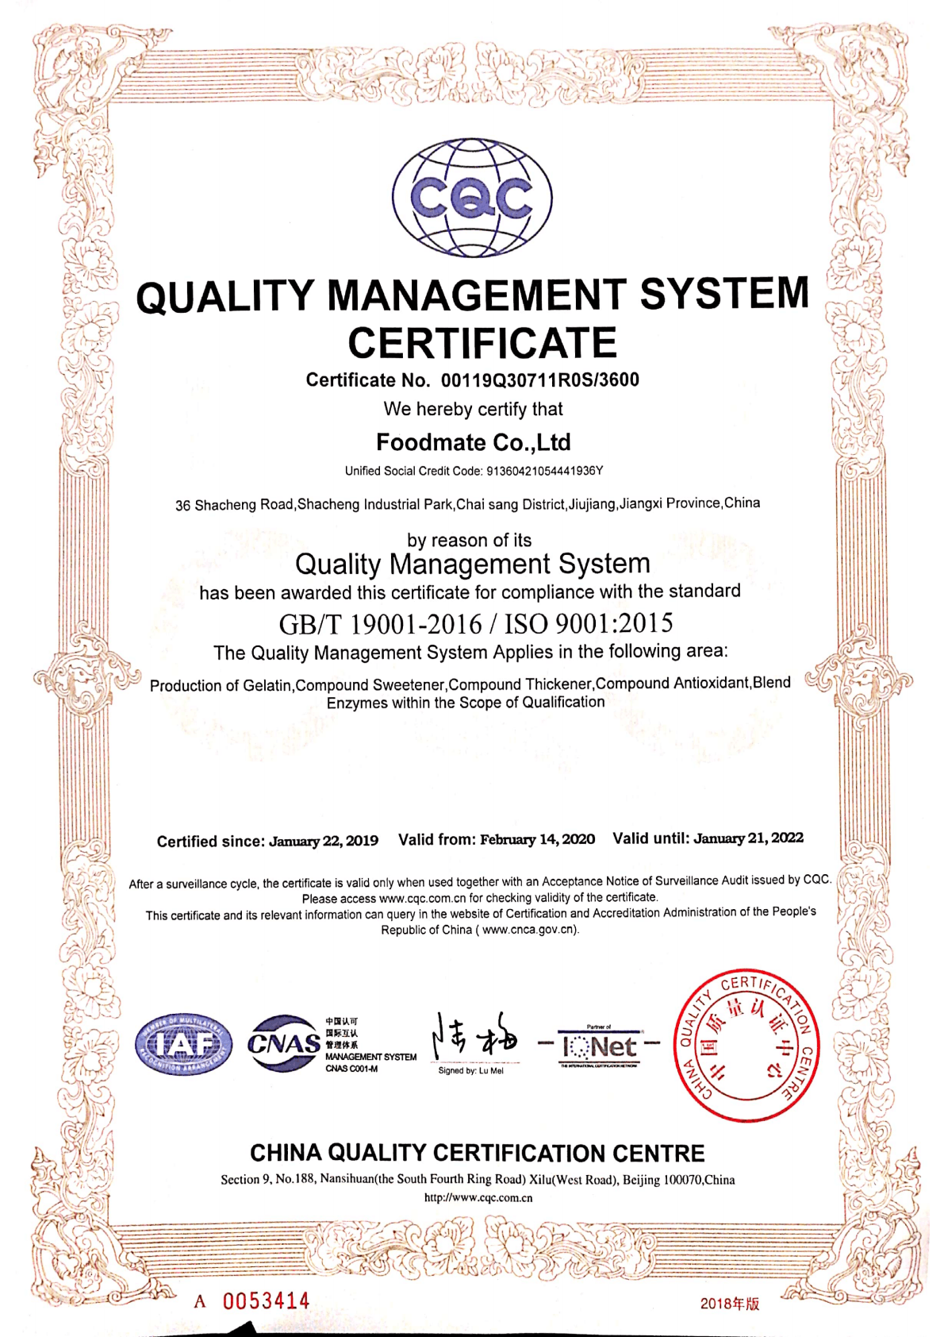
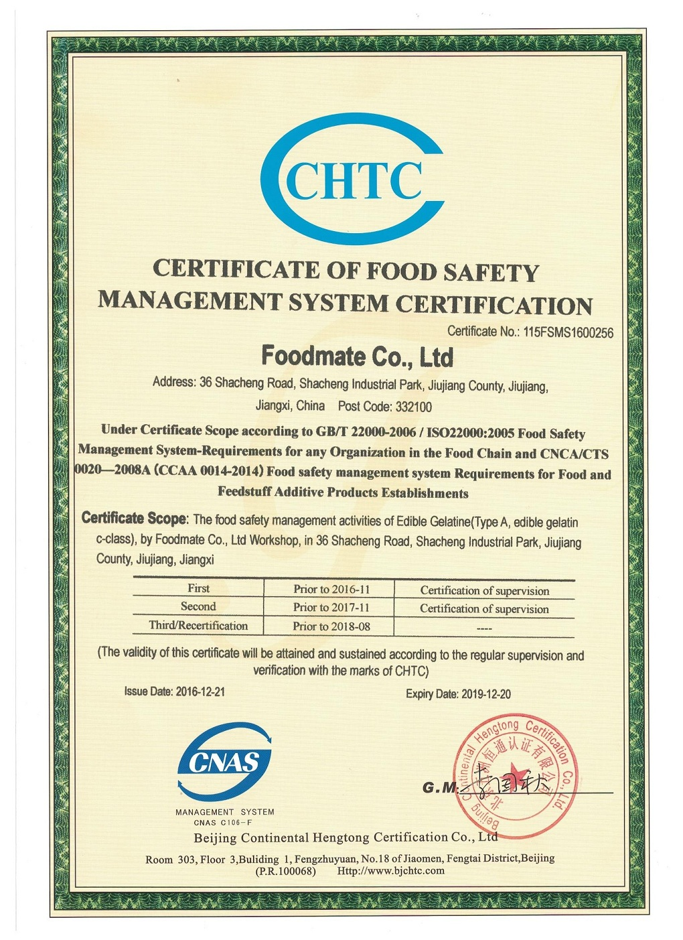
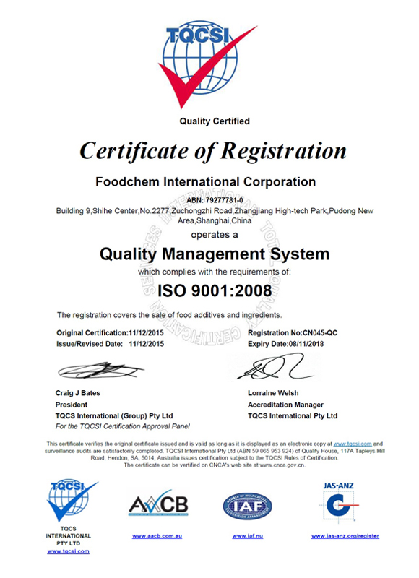
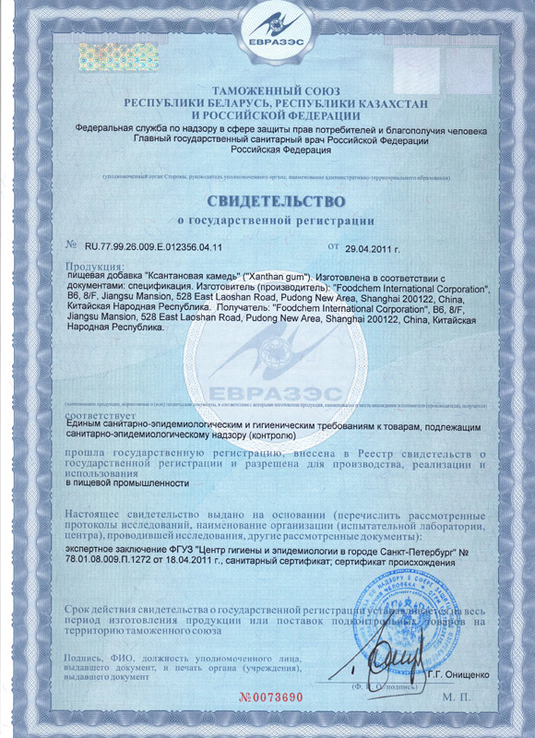
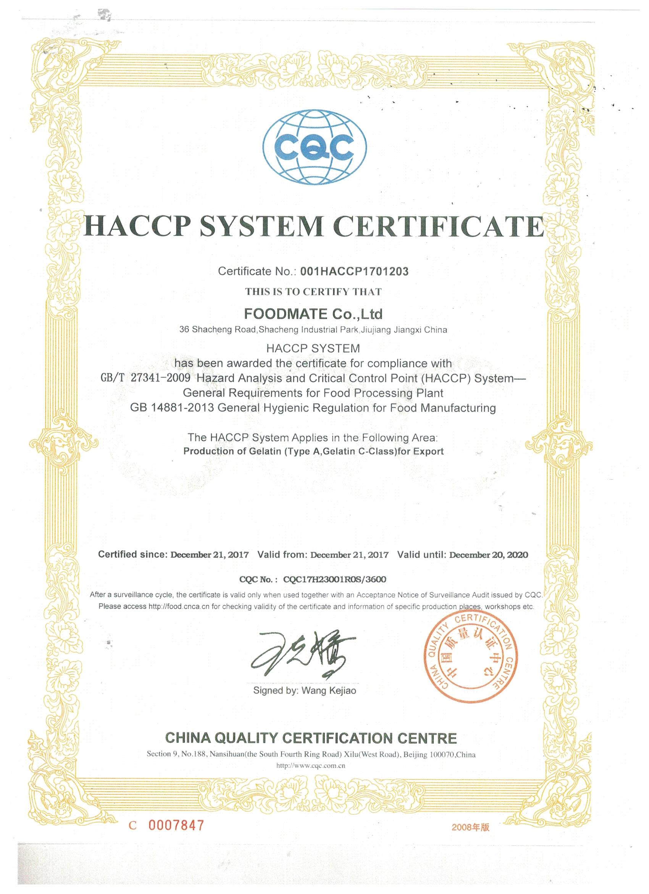
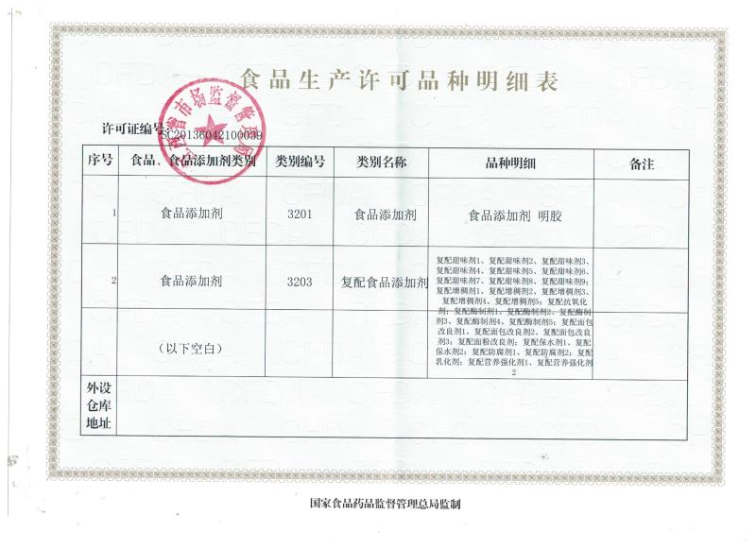
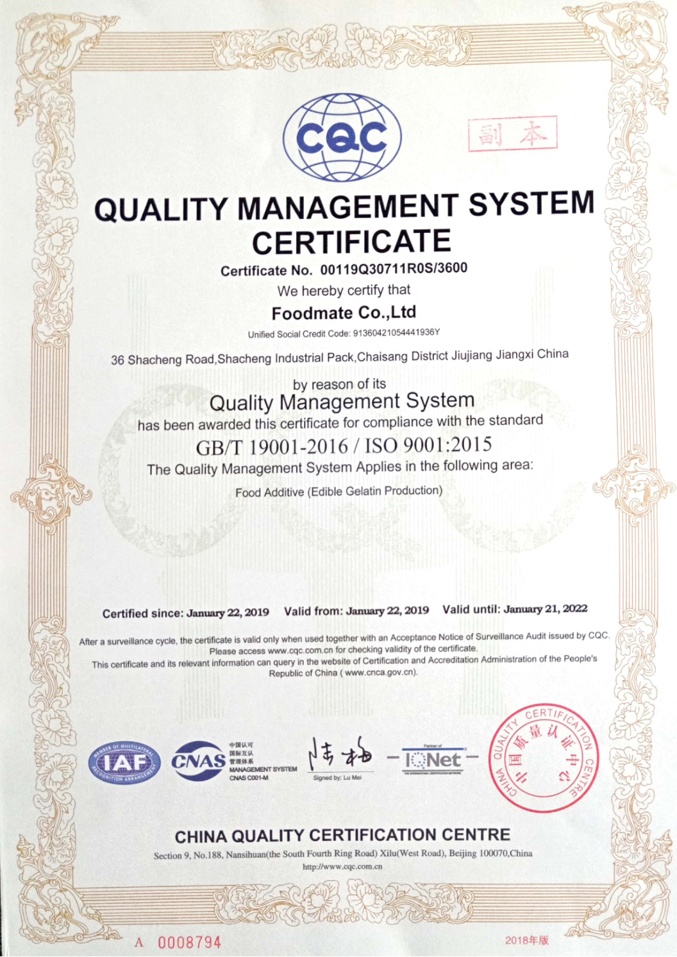
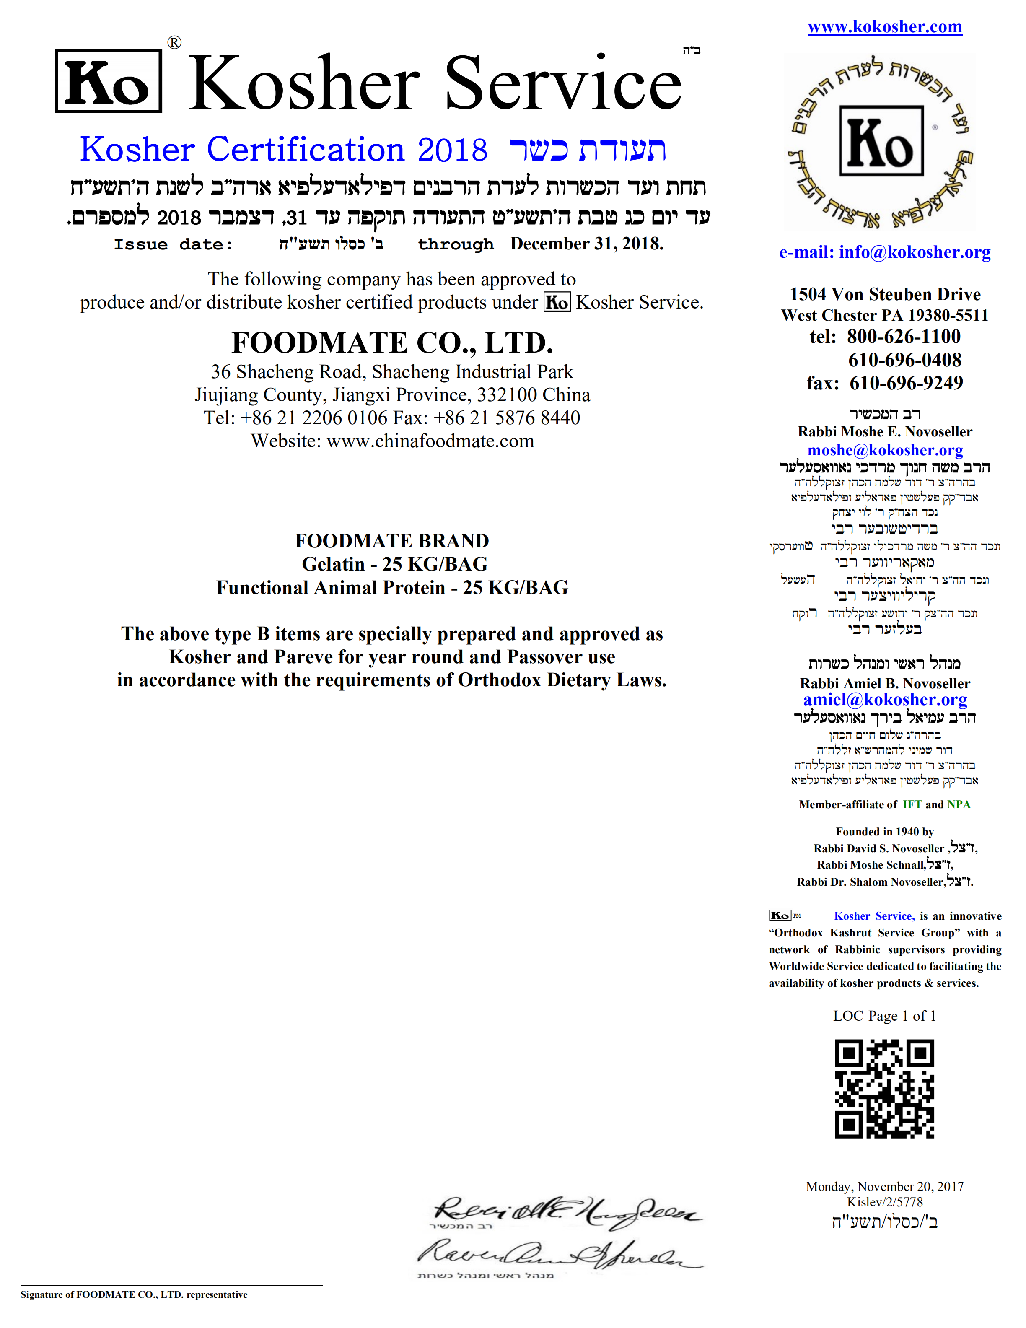
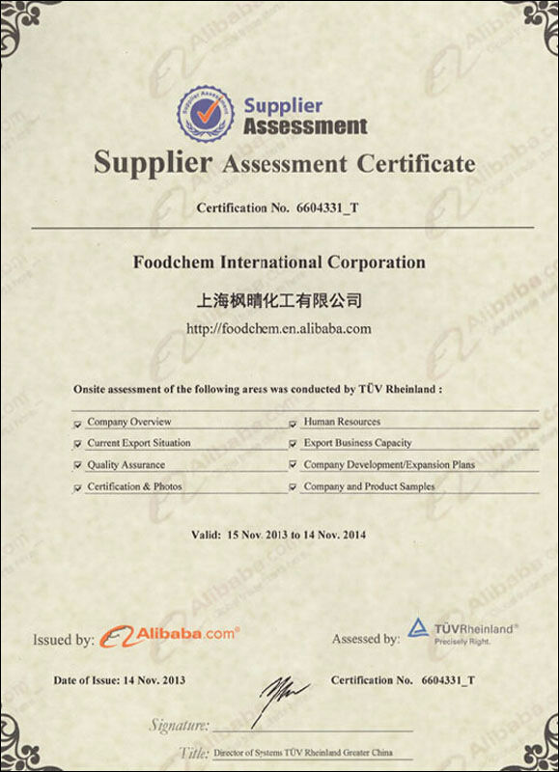
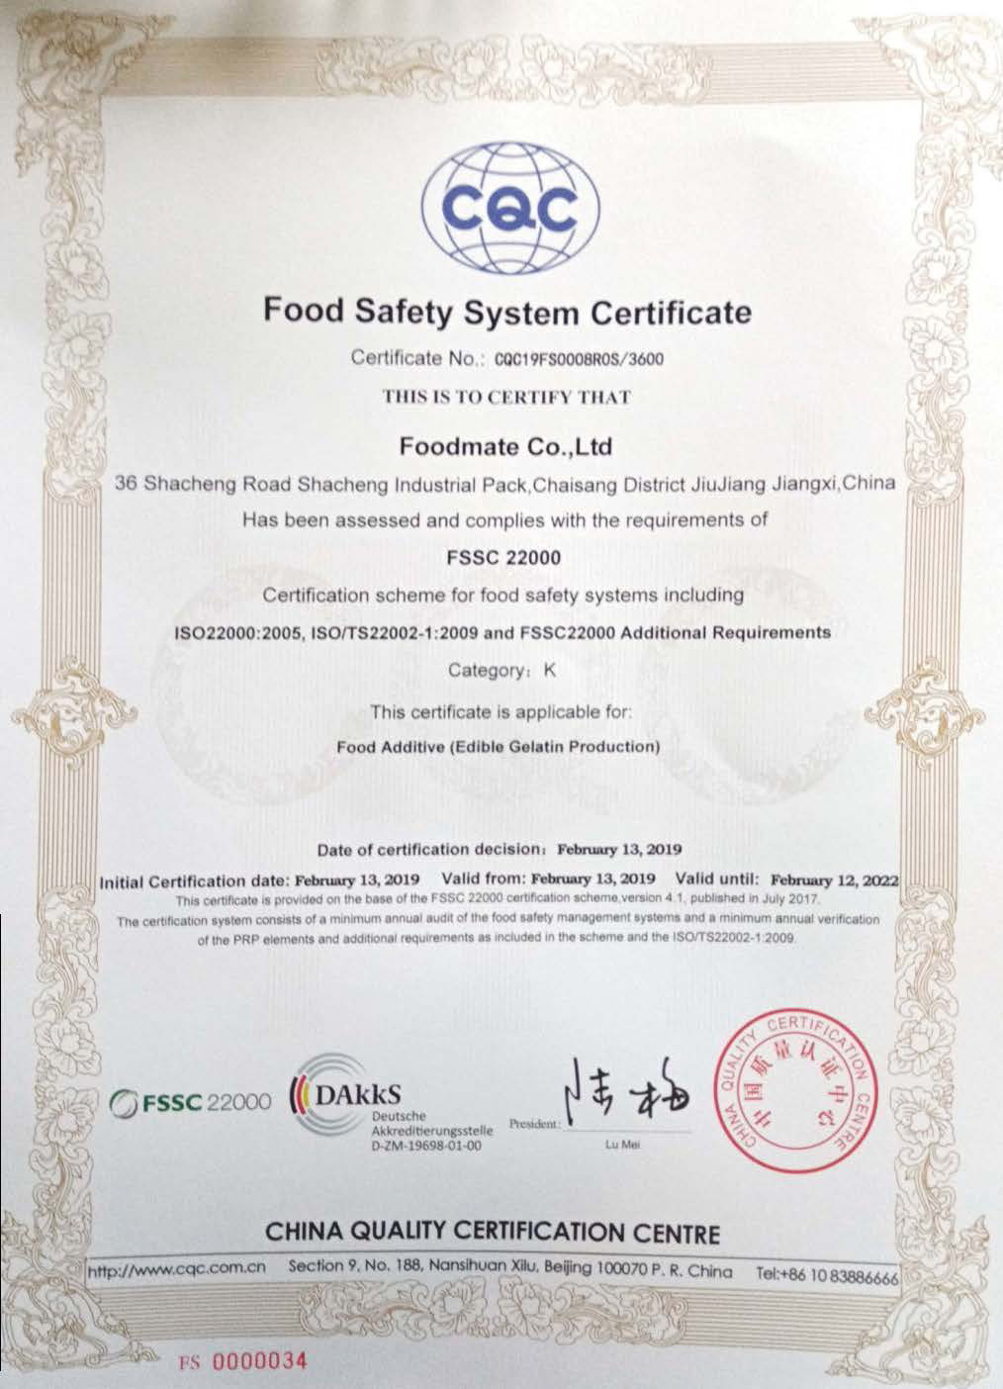
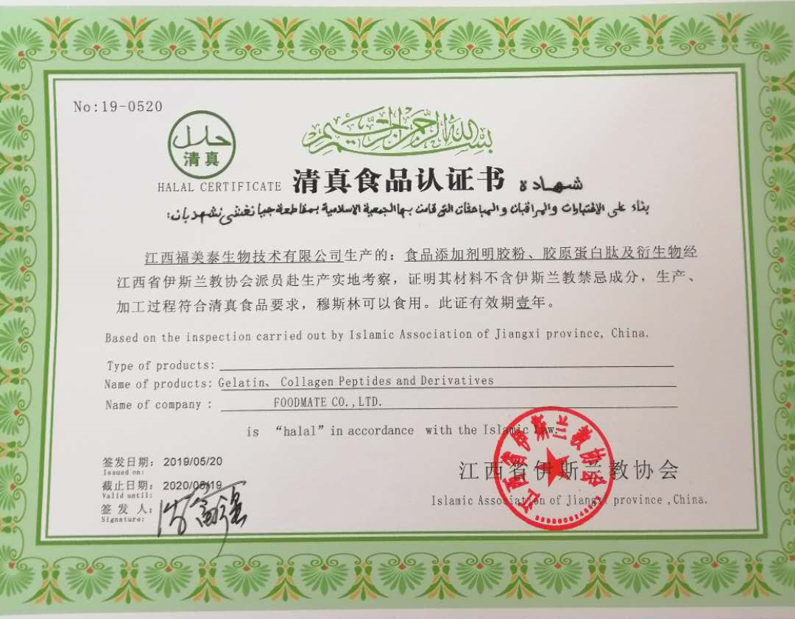
04
Certificate System
Certification System Complies With Industry Standards
Foodmate has abided by food safety, and has been recognized and certified by Chinese and international institutions.
www.foodmategroup.com

Slide 7
05
Supply System
Setting of Evaluation Standards
Foodmate implements strict supplier access system, carry out strict screening and evaluation, from the source to ensure the quality of the product supply chain system.
Comprehensive Management Capability
Organization
Operation Plan
Human Resources
Corporate Culture
Ethics
Quality System
Production Capacity
System
Quality Control
Quality Assurance
Equipments
Capacity
Shift
Bottle
Process
Technology Development Capability
Cost Control Capability
R&D Investment
Developers
Development Speed
Technical Services
Cost Reduction Plan
KPI Management
Financial Capability
Communication Skills
Financial Stability
Operating Capability
Financing Capability
Speed
Attitude
Language
Information Technology
Service
Delivery Quality
Timeliness
Improvement Methods and Plans
Customer Satisfaction
www.foodmategroup.com

Slide 8
05
Supply System
Professional Suppliers Selection Procedure
Foodmate follows a very strict supplier screening process to ensure that each selected supplier meets our inclusion criteria.
Existing Supplier
Purchasing BBS
Qualified
Suppliers
Base
Trade journals / Exhibitions
Suppliers Long List
Suppliers
Short List
Site Assessment
Upstream and downstream of suppliers
Network/ 3rd Party
Vendors Advertise
Supplier Review
Supplier Self-checking Table
Supplier Survey
www.foodmategroup.com

Slide 9



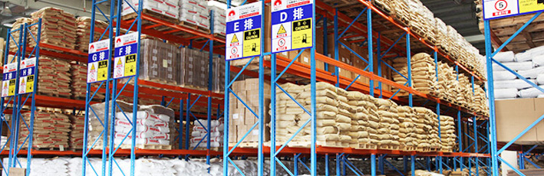
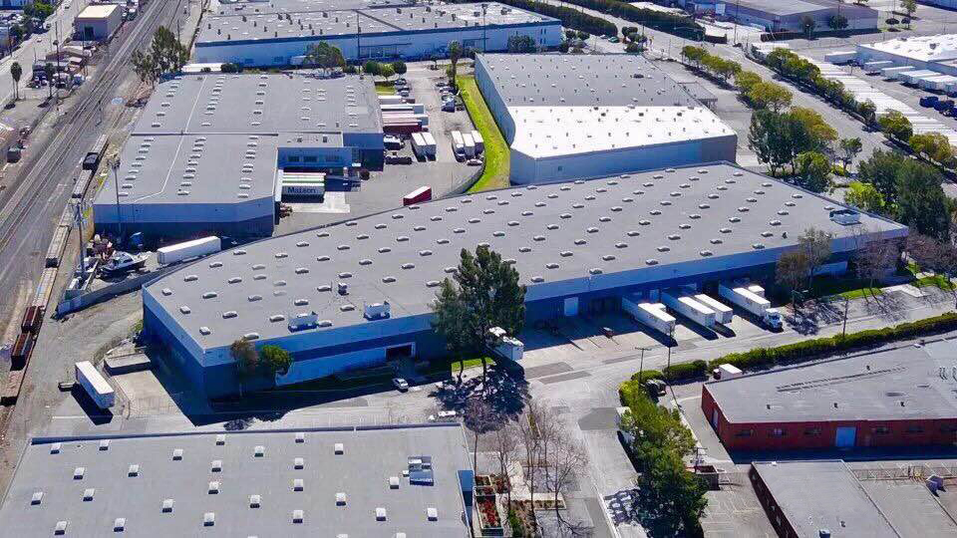
06
Warehousing System
Gobally Deployed Warehousing System
At present, Foodmate has 4 industrial application centers, one professional laboratory, 2 factories and 3 global warehousing centers. So far, Foodchem has provided professional services for 5,000 customers in 120 + countries and regions.
Warehouse Location
Warehouse Capacity
AREA
Over 6,000 square meters
Storage Capacity
Over 5,000 tons
Warehouse Site Management
stereoscopic warehouse
Warehouse Information Management
The world's leading WMS system
Bar code management
European
L.A. USA
Tianjin
Qingdao
Jiujiang
SFTZ(Shanghai Free Trade Zone)
Shanghai
Abroad
China
www.foodmategroup.com

Slide 10
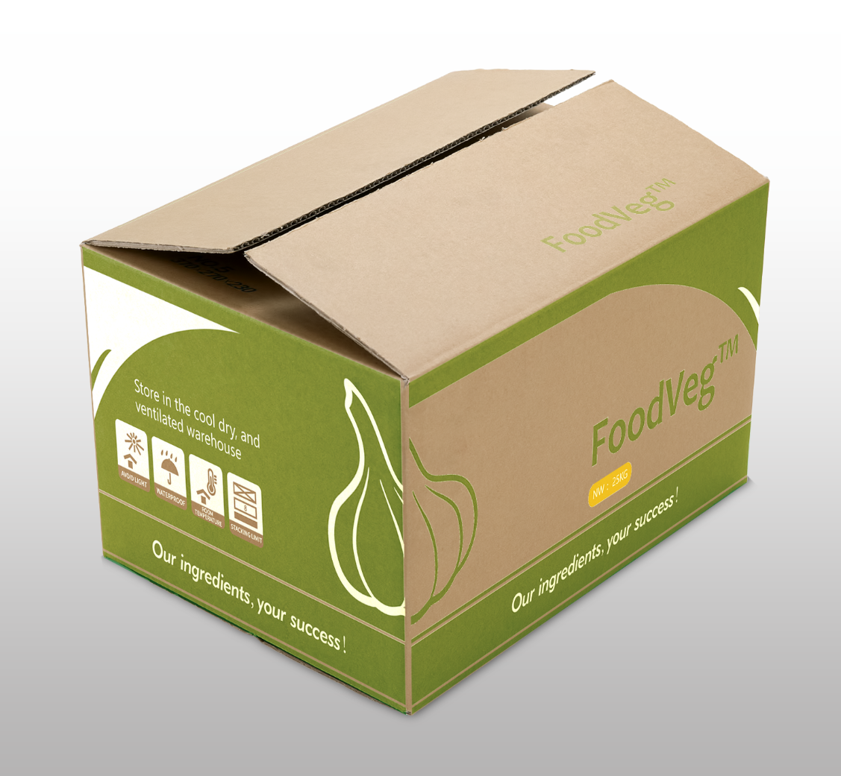
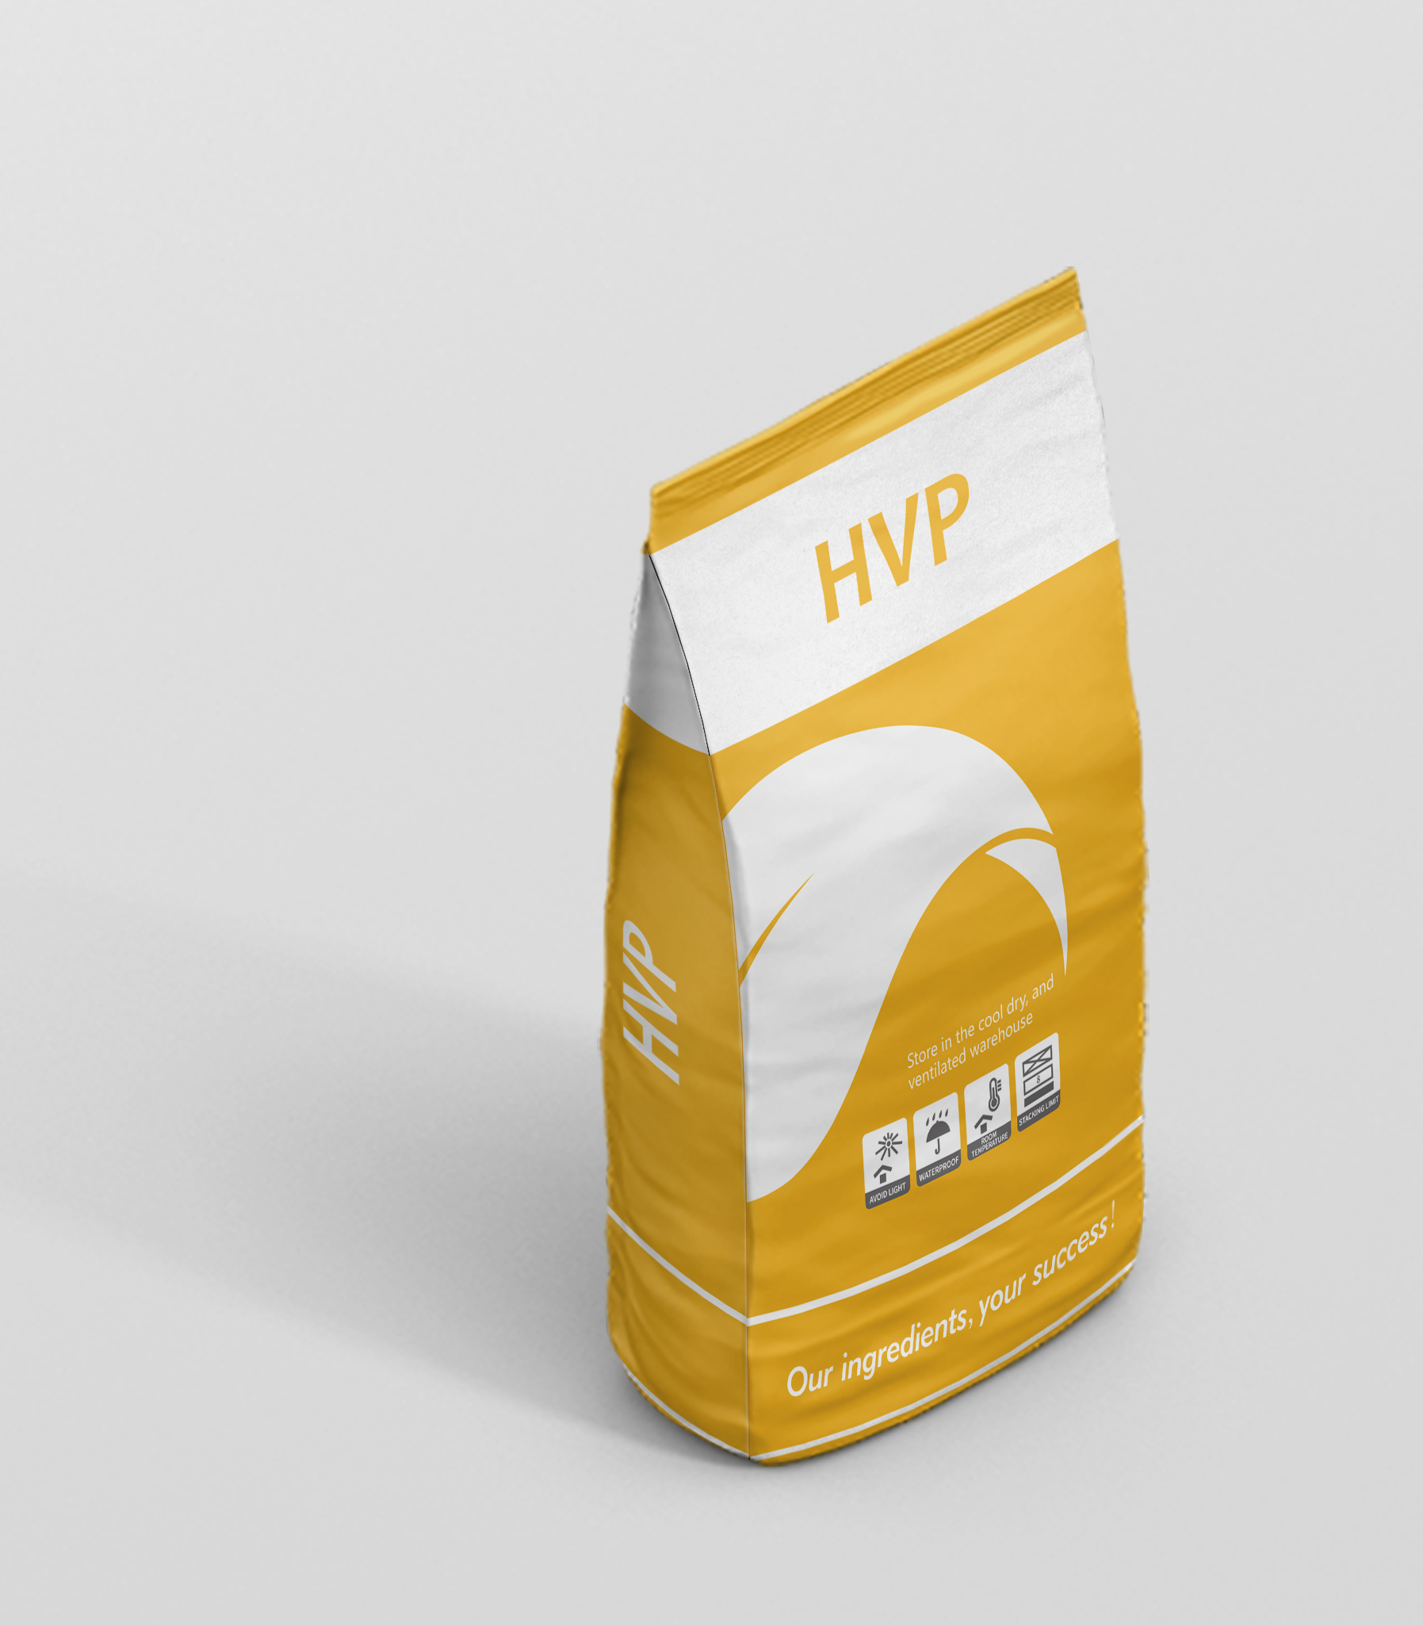
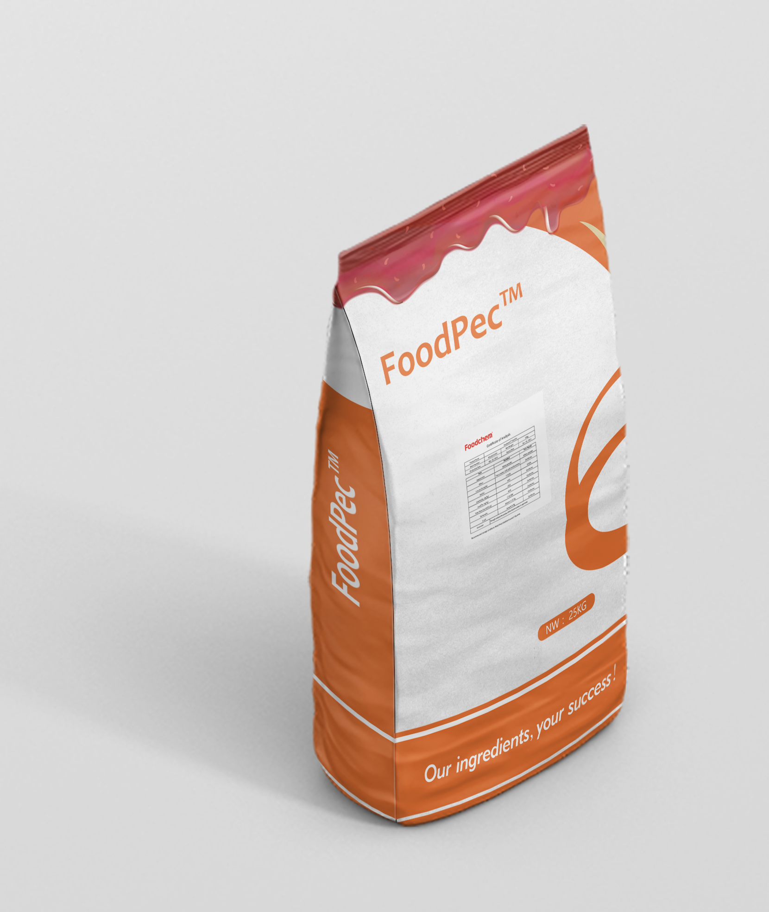
07
Packaging System
World-class Brand Packaging System
Foodmate has established a brand development strategy to adhere to the use of world-class brand packaging model in product packaging.
High-strength material which comply with Food Sate Requirement
Same Supplier with CARGILL,BASF,DUPONT,NESTLE
Completely sealed for Moisture Proof & Anti-block
Standard work flow & procedure for packing&shipping
www.foodmategroup.com

Slide 11
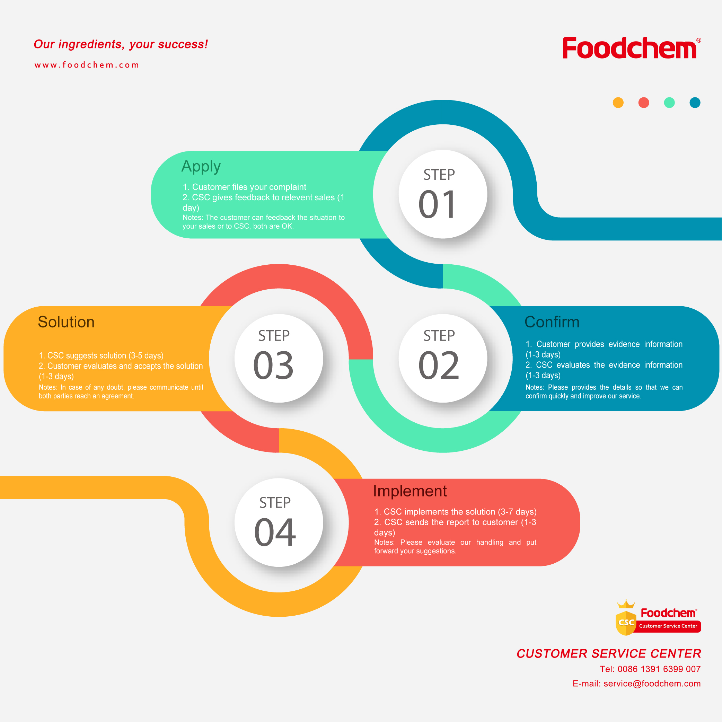
08
Service System
Professional and Reliable After-sales Service System
Foodmate provides you with professional after-sales services. From pre-sales consulting to after-sales service, we provide professional high-quality service.
Apply
Supervision and execution of marketing activities
Customer care
Customer complaints handling
Order execution service supervision
Customized services for VIP customers
Customer satisfaction survey
Solution
Confirm
Implement
Customer complaints handling process
www.foodmategroup.com

Slide 12

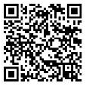
Nik Wu
Marketing Department
E-mail: nik@foodchem.com
Tel: 0086 21 31267000 ext. 667
Fax: 0086 21 58768440
Mob: 0086 13402026808

