Slide 1



Customer Service Center
Membership Point Reward Plan 2020
Foodmate Co., Ltd.
www.foodmategroup.com

Slide 2

Catalogue
01
How to be Foodmate Member
How to evaluate membership level
Foodmate Member
02
How to get Membership point
The usage of Membership point
Membership
Point
03
How to confirm your member level and points
How to calculate your member points
How to use your member points
Operation Manual
Customer Service Center

Slide 3





1
Foodmate
Memeber
How to be Foodmate Member
Evaluate membership level
Gain the growth value of customers
Evaluate the membership level according to the growth value of the previous year
Shipment/history of cooperation/other behavior can get corresponding growth value
Purchase from Foodmate
Enjoy benefits of member
Every purchase generates additional value
Enjoy corresponding member level benefits in the current year

Slide 4




1
Foodmate
Memeber
How to evaluate membership level
Fine adjustment
Growth value of the previous year
Member level | Growth value
Diamond | ≥1,000
Gold | ≥500 ＜1,000
Silver | ≥200 ＜500
no restrictions on member level promotion
only be downgraded one level
evaluate once a year on January 1st
member level is valid in the current year
calculate the growth value of the previous year
growth value last year=shipment amount last year/1,000+quantity of the longest consecutive order months of last year(≥20,000)*2+quantity of consecutive years of membership (since 2019)*5
officially launched on June 1st, 2020
total shipments of the previous year
member level last year
other behavior data
Evaluation data source
Member level evaluation standard

Slide 5






2
Memebership point
How to get Membership point
process
get points
process
multiplel points
condition
goods shipped and full payment completed
condition
participate in mutiple point reward marketing activities
qualification
multiple
Shipment
Activity
process
process
available points
condition
be evaluated as Foodmate member level
Membership
Vality
condition
points within the validity period can be used

Slide 6


2
Memebership point
The usage of Membership point
Deduction
Exchange
Order deduction
Physical gifts
Virtual gifts
1 Member point = 1 USD
Note: Part 3 has a detailed description of the rules and procedures for the use of points.

Slide 7




3
Operation Manual
How to confirm your member level
Automatic Calculation
The system automatically records and calculates the growth value of customers in the previous year
Level Update
Automatically updated on January 1st every year based on last year's growth value
Confirm Way
CSC will inform your new member level every year by email/sns etc., and you can communicate with your exclusive business representative or CSC at any time to confirm your membership level and points

Slide 8




3
Operation Manual
How to calculate your memeber points
Actual reference cases
Confirm multiple
Actual points
calculation
Diamond: *6
Gold: *4
Silver: *2
According to actual shipment amount
RU071xxx28
Dimond Member
fx
Recent Order Date
Recent Order Amount
Points of This Order
2020-04-16
USD 516,200
3097.2
Single order calculation
Order amount/1000*multiple
Specific calculation process:
Order amount/1000*multiple
=516,200/1000*6
=3097.2

Slide 9




3
Operation Manual
How to use your memeber points
Current standard process
Confirm
Update
Exclusive business representative confirms specific application
Specific order(deduction)
Specific gifts(exchange)
Data deduction and synchronous update of corresponding integral
Apply
Implement
Customer applies for using points
deduction or exchage
how many points
According to the use plan of points confirmed by both parties
Decrease of order paid in amount(deduction)
Purchase designated gifts(exchange)

Slide 10



3
Operation Manual
How to use your memeber points
Operation manual-Order Deduction
The proportion of order deduction for single order：
≤50%
Apply for order deduction
Decrease of order paid in amount
Customer
Check the available points
Apply for point deduction when building order
insufficient
Representative
Member point system
Automatic recording and updating
sufficient
CSC

Slide 11
3
Operation Manual
How to use your memeber points
Operation manual-Exchange Gifts
The express fee of gifts shall be deducted with points.
Customer sends the gift information or purchasing link.
Representative sends the gift information or purchasing link, and the customer confirm it.
Recommend Amazon, tmall, JD and other high-quality e-commerce channels.
The gifts purchased shall comply with relevant laws and regulations.
Apply for exchange gift of member points
Receives the designated gift
Customer
Check the customer's available points
Apply for exchange gift in system
insufficient
Representative
sufficient
Member point system
Purchase and send designated gifts
Automatic recording and updating
CSC

Slide 12
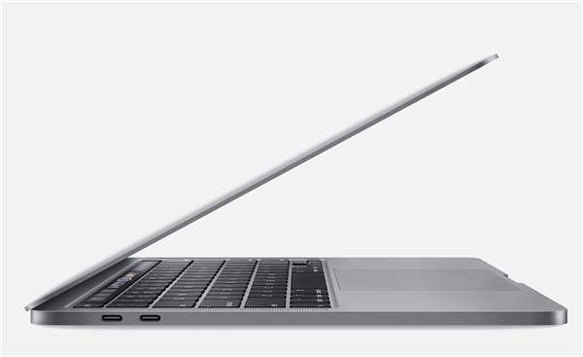
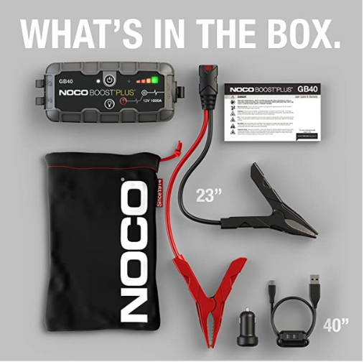
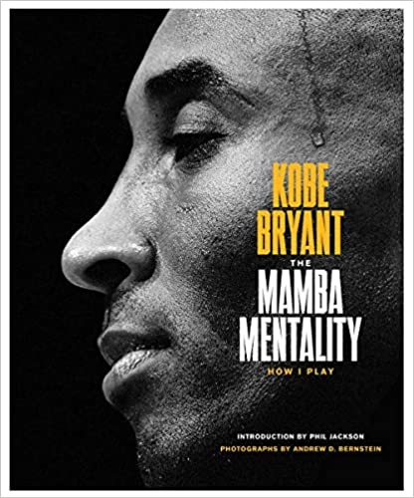

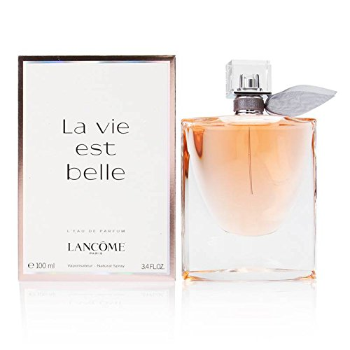
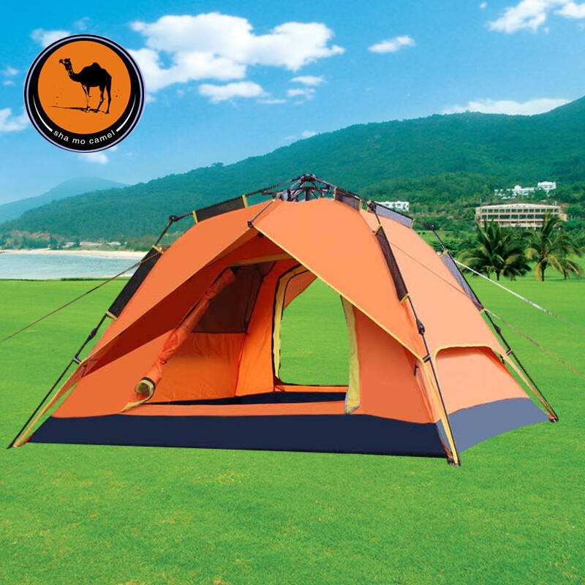
3
Operation Manual
How to use your memeber points
Reference gift-Exchange Gifts
The Mamba Mentality: How I Play
NOCO Boost Plus GB40
amazon.com
Price: $125
Points: 125
2020 MacBook Pro 13.3
amazon.com
Price: $18
Points: 18
jd.com
Price: ￥14,499.00
Points: 2,100
Camel automatic outdoor tent
HUAWEI P40 Pro 5G
Lancôme La Vie Est Belle
tmall.com
Price: ￥5,988.00
Points: 855
amazon.com
Price: $120
Points: 120
tmall.com
Price: ￥269.00
Points: 38

Slide 13

Customer Service Center
Our service, your trust!
Foodmate Co., Ltd.
Tel: +86-21-2206 0106
WhatsApp: +86-134 8242 4189
Email: service@foodmategroup.com

